Slide 1
Data Visualization methods on medical survey
Ionescu Emma, gr. 511
Elena hrincescu, gr. 511

Slide 2
Subject of analysis
This report shows information plots using different libraries in Python (matplotlib, seaborn, plotly) and PowerBI
Data is based on CDC BRFSS Survey 2022 and contains information on different health indicators for US-citizens

Slide 3
Dataset description
Size: (445132, 40)
Columns: State, Sex, GeneralHealth, AgeCategory,..
Types of variables: majority, categorical, some are numerical (weight, sleep hours)
Columns with nans: GeneralHealth, ChestScan, HadCOPD,..
Categorization of columns: characteristic, lifestyle, medical

Slide 4
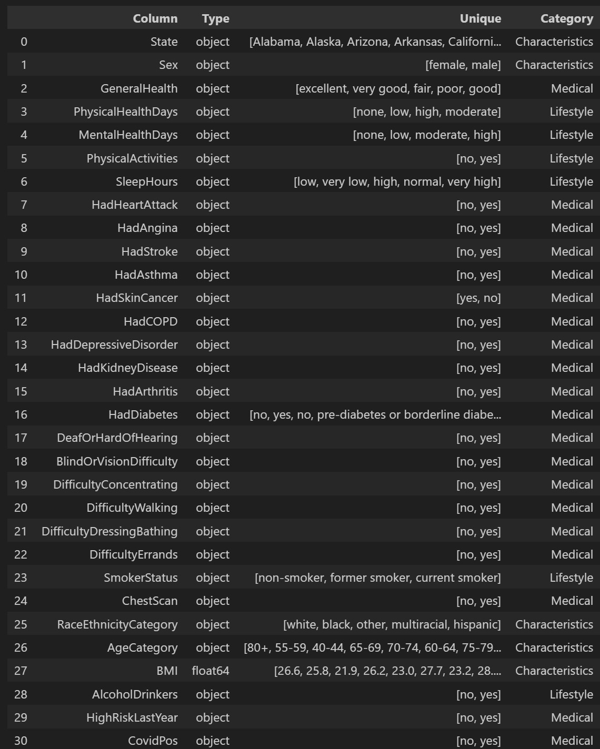

Slide 5
Data cleaning
There were performed several actions for cleaning the initial dataset in order to continue with the analysis:
Removed columns that were not giving enough relevant information: RemovedTeeth, HIVTesting, FluVaxLast12
Binned certain variables for decreasing the variance: BMI
Applied functions that based on certain conditions could fill nan values:
BMI: calculated manually weight/height²
ChestScan: if a person had one of the heart affections mentioned, for diagnosing it it must have done a chest scan
Mobility Issues
General health: if a person has no medical disorders

Slide 6
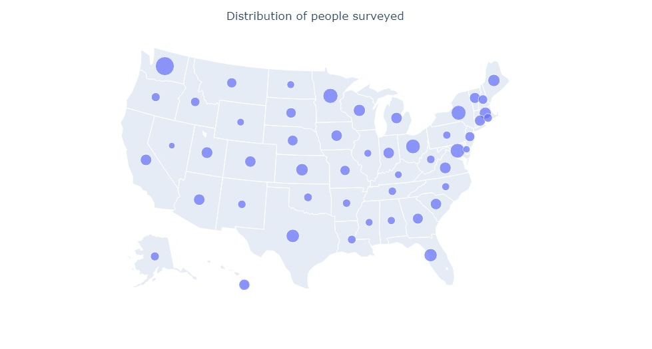
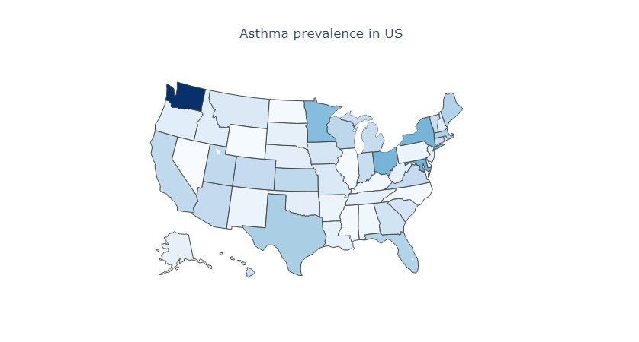
Map Plots
Plots in Pyhton
Survey contains answers of respondents from all 50 states of the United States
The state with the highest number of people surveyed is Washington

Slide 7

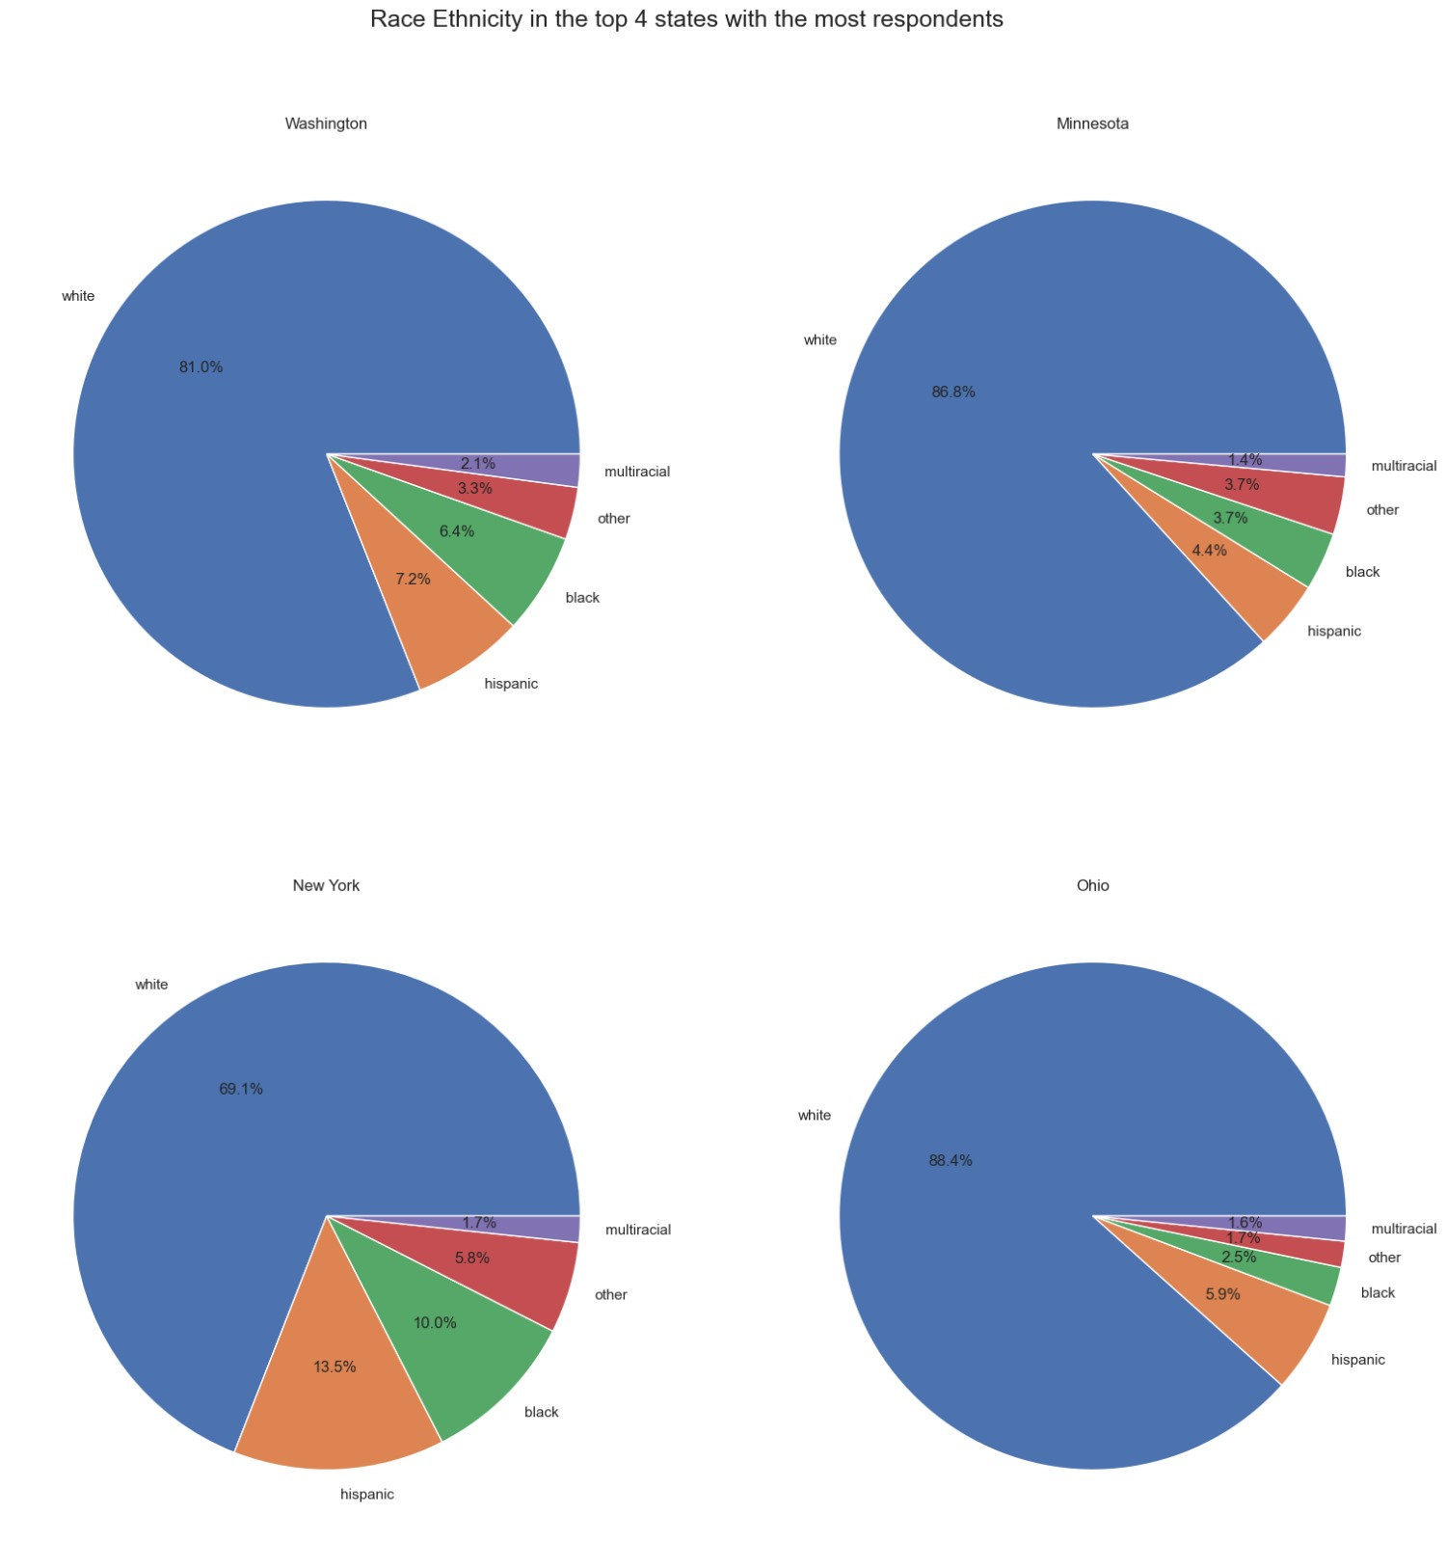



Race/ Ethnicity in the top 4 states with the most respondents

Slide 8
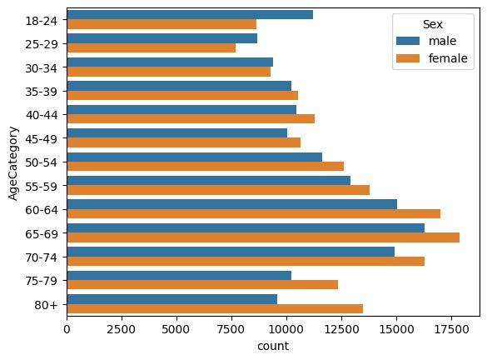
Bar plot showing the number of people within each age category
13 age categories, in 4 year increments
Ages from 18 to 80+
Respondents split by Gender for each Age Category

Slide 9
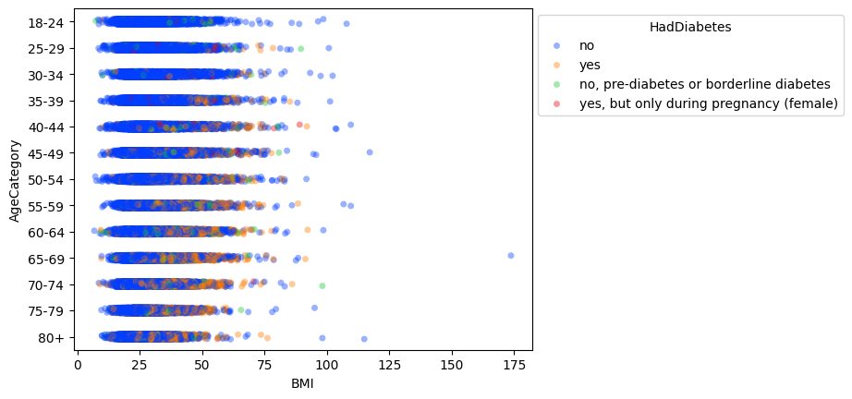
Strip plots showing the distribution of BMI within each age category and coloring if the person has Diabetes

Slide 10
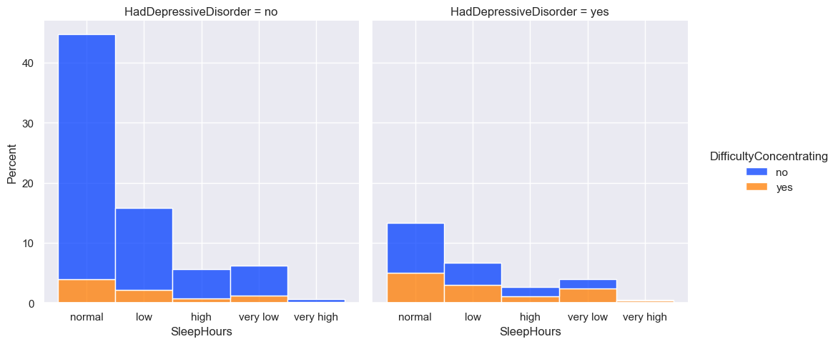
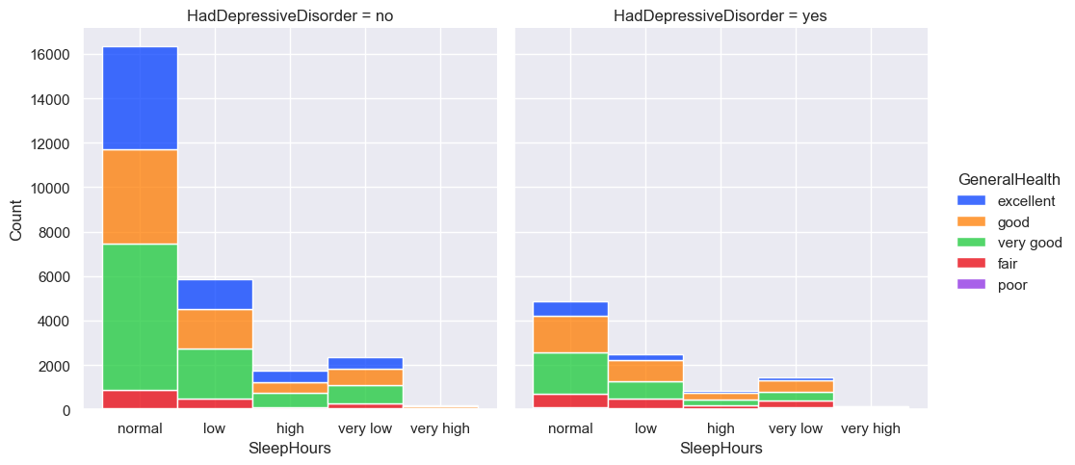
Stacked Bar Plot analyzing the sleep pattern

Slide 11
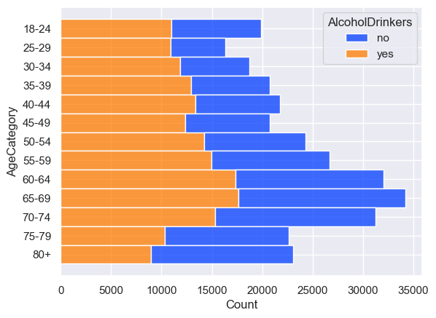
Bar Plot showing the alcohol drinkers within each age category

Slide 12
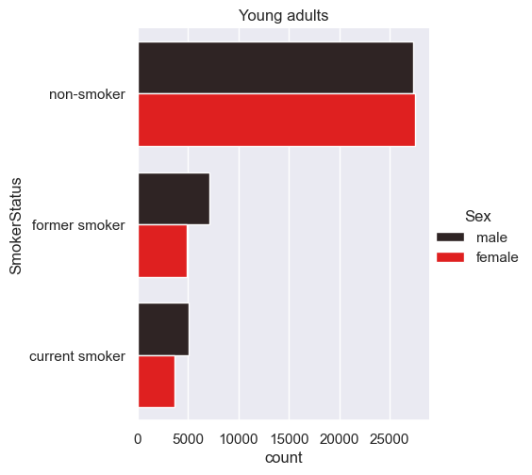
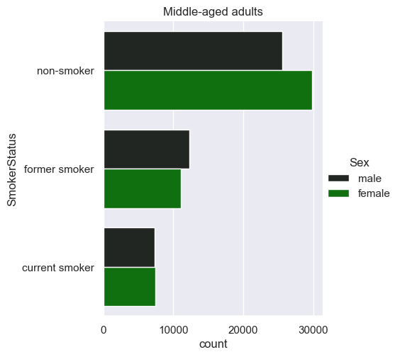
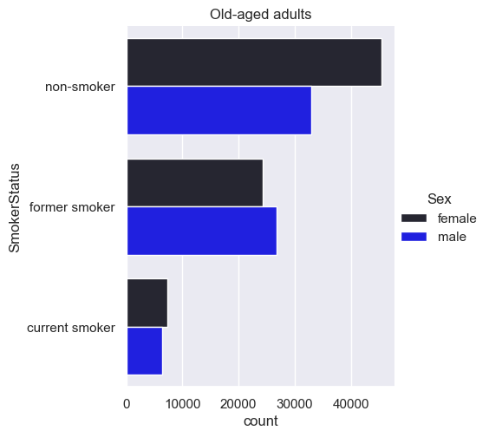
Bar Plots showing for grouped age categories (young adults, middle-aged adults, old-aged adults) the smoker status

Slide 13
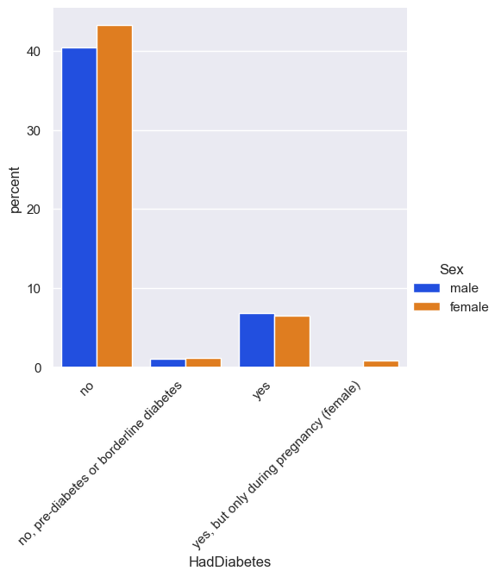
Bar Plot showing the percent of Male-Female people that have diabetes

Slide 14
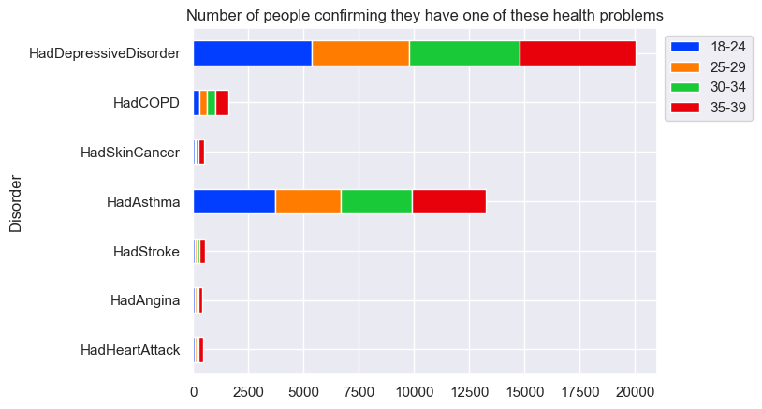
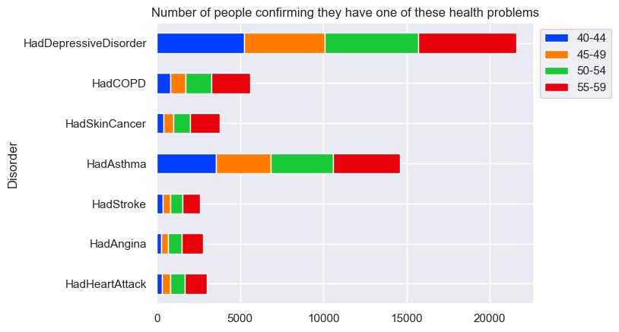
Stacked Bar Plot showing the number of people suffering from at least on

Slide 15
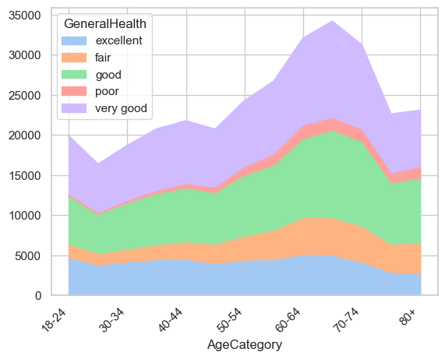
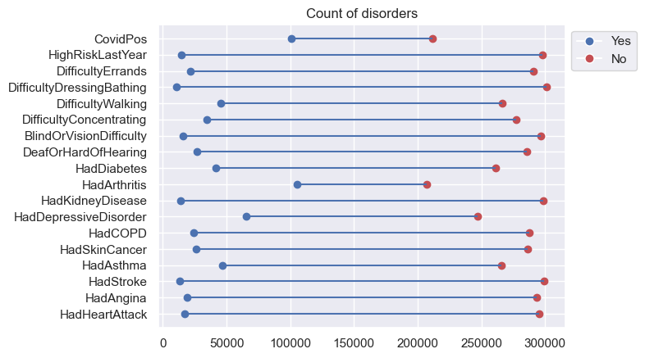
Stacked Area Chart
Lollipop Plot

Slide 16
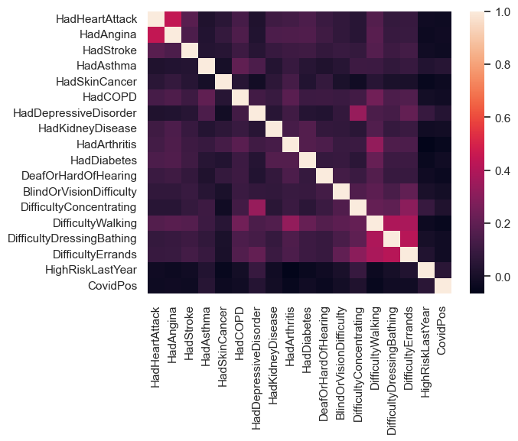
Heatmap of correlation between disorders

Slide 17
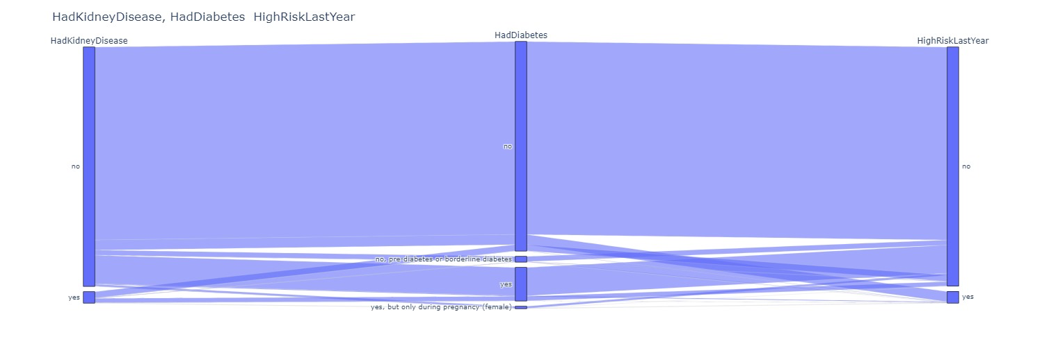
Parallel categories Plot for analyzing people with kidney disease, diabetes and with high risk last year

Slide 18
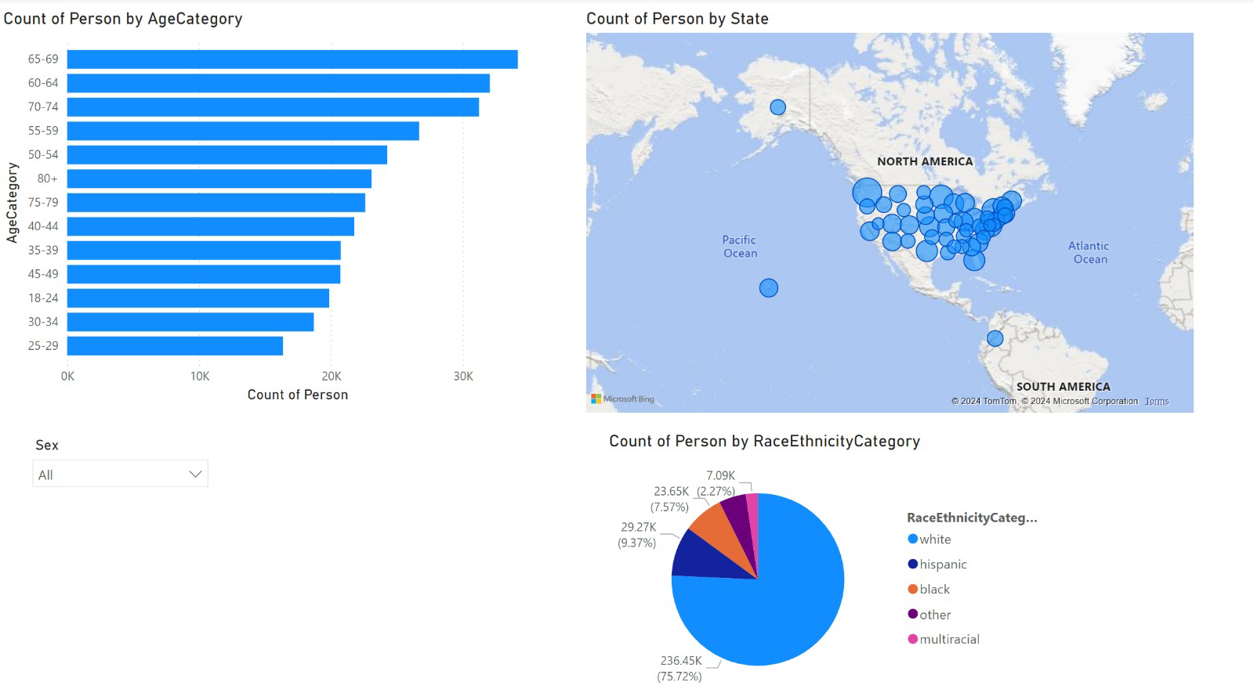
Plots in PowerBI
The first page of the report shows general information of the people interviewed

Slide 19
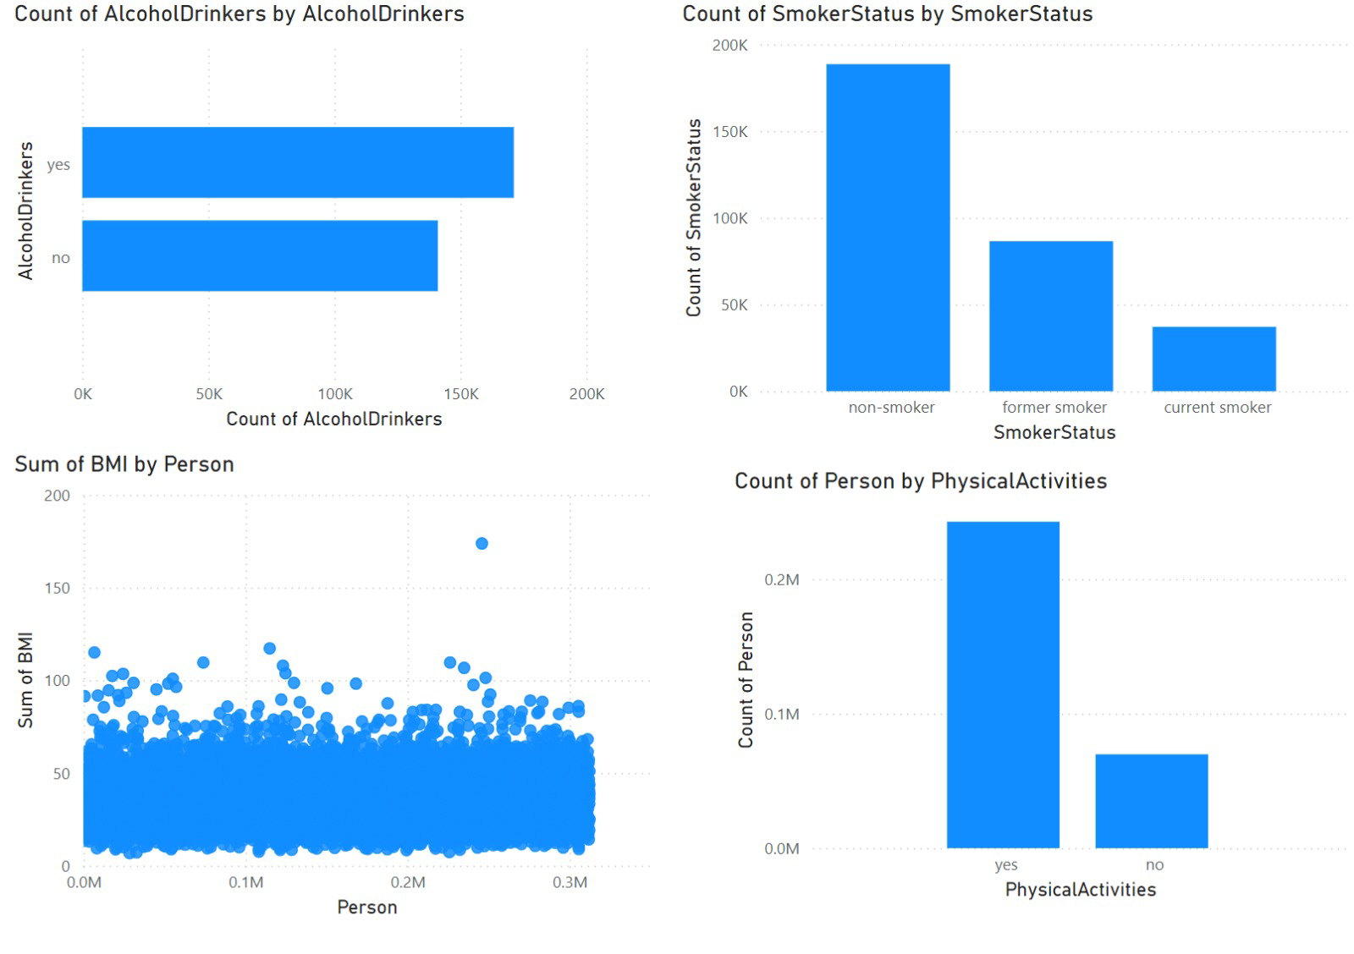
The second page contains plots about other characteristics and lifestyle choices

Slide 20
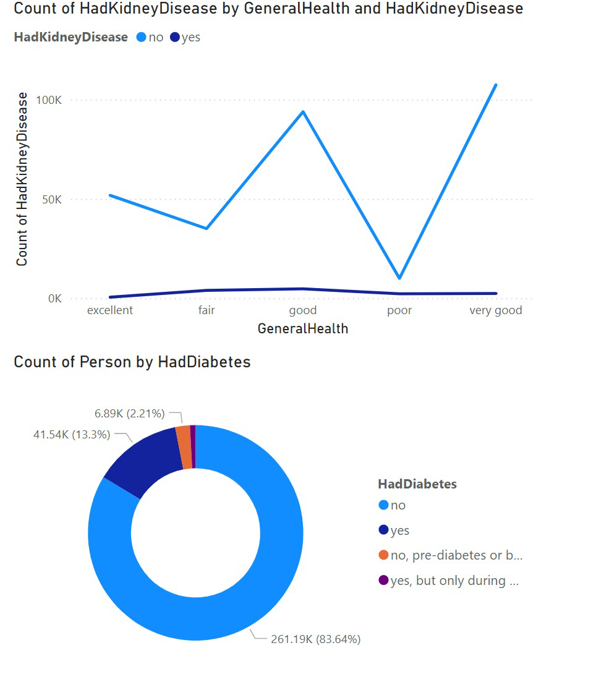
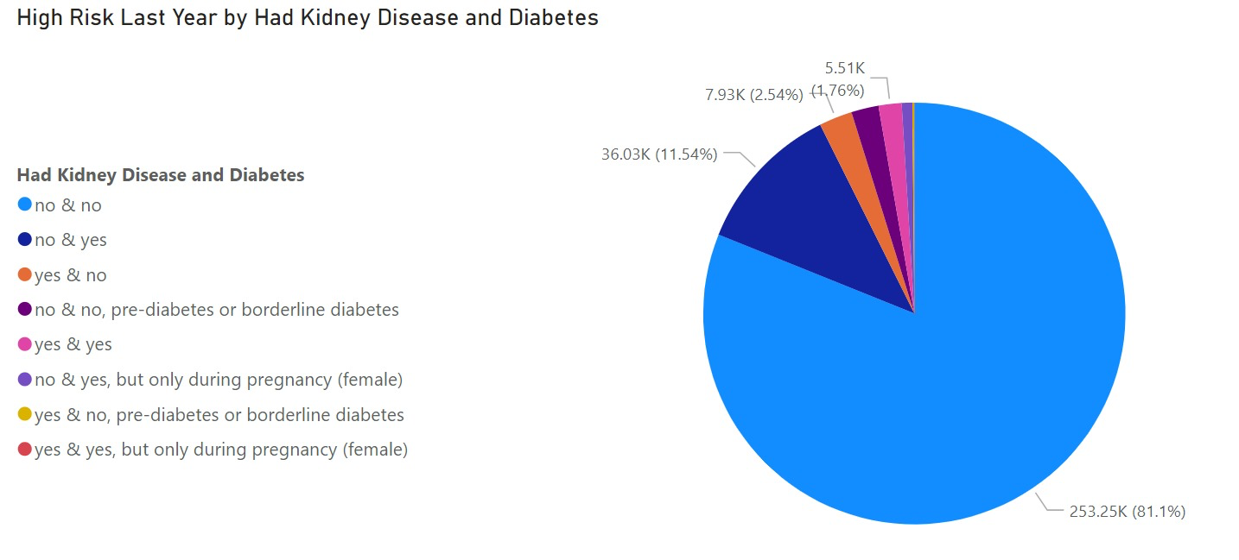
The next pages contain plots about medical disorders, their distribution and relation with other factors

Slide 21
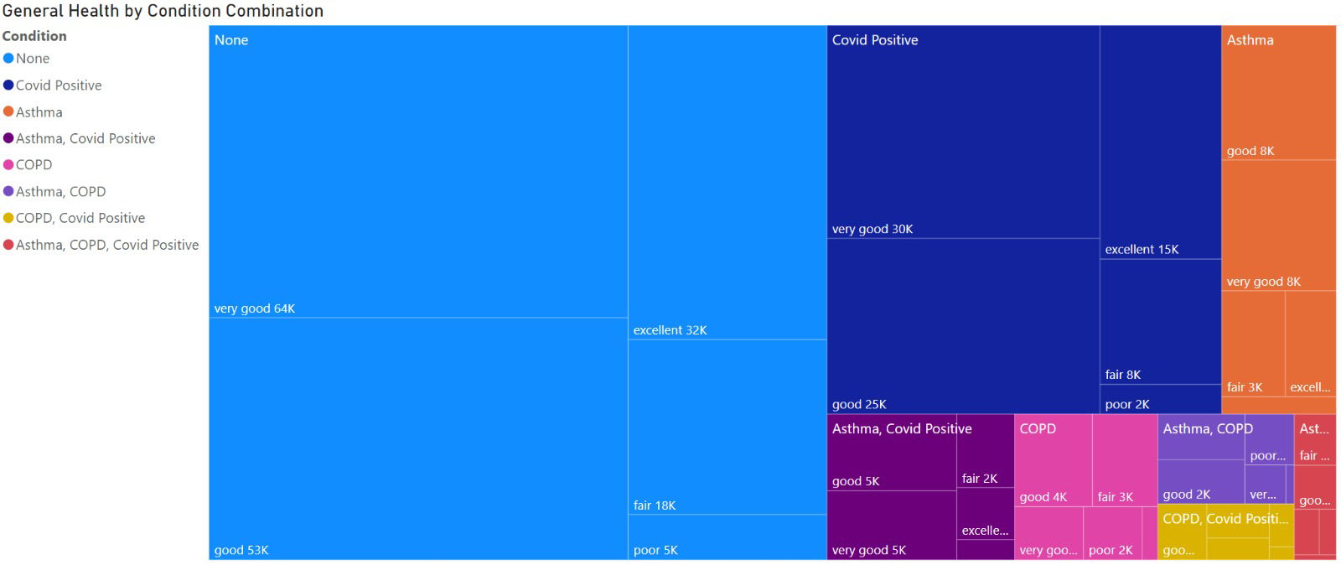
Custom tree map showing the number of people having one or multiple disorders and their general health status

